Slide 2
How We Got the Bible
Textual Criticism

Slide 3
General Outline
Gnostic Gospels & Beyond
Textual Criticism
The Catholic Era & The Reformation
The Bible in Your Hand

Slide 4
The Autographs
An “autograph” is a manuscript penned by the author himself.
We have ZERO autographs of any Bible book.
Instead, we have thousands of copies, fragments, and versions.
Textual criticism is the field of study that assesses that body of evidence to discover the most authentic text of the Scriptures.

Slide 5
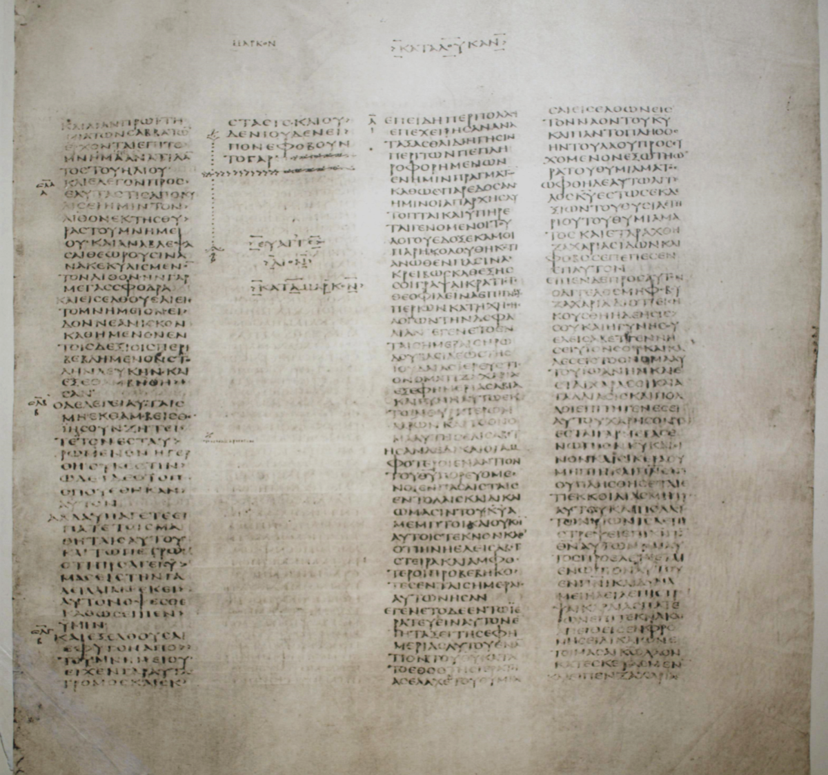
Codex Sinaiticus

Slide 6
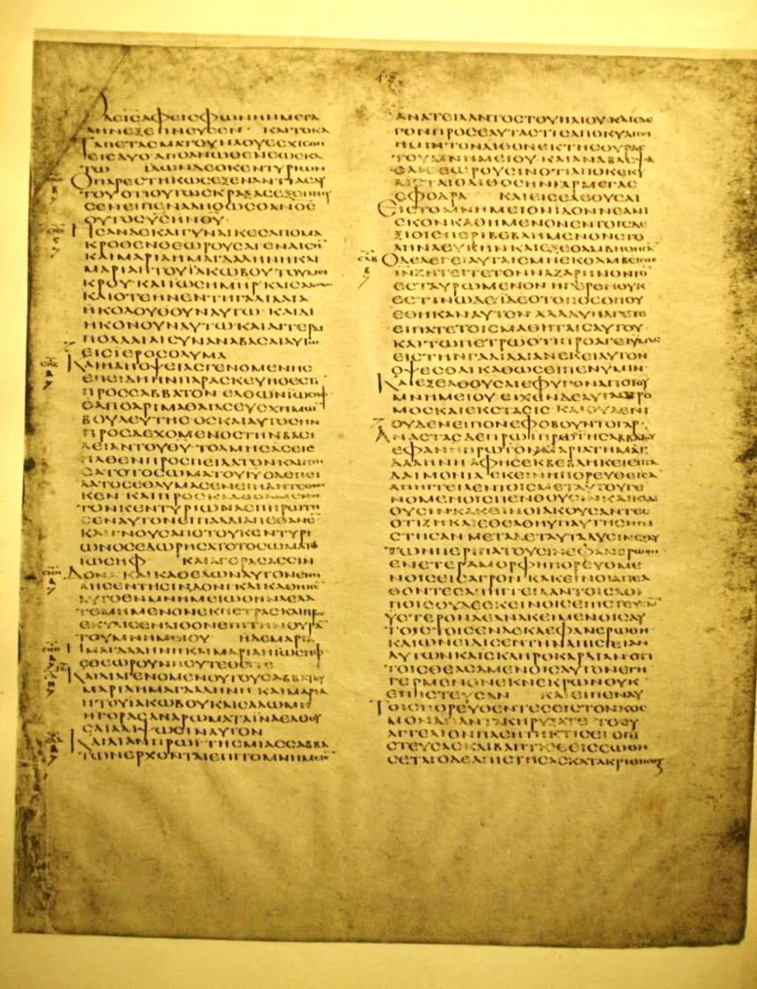

Alexandrian Manuscript

Slide 7
An Example
IMAGINEABOOKWRITTENINENGLISHBUTWITHOUTANYKINDOFSPACESORPUNCTUACTIONMARKSOFANYKINDITHINKTHATWECOULDAGREETHATITWOULDBESOMEWHATDIFFICULTTOREADESPECIALLYIFENGLISHISNOTEVENYOURNATIVELANGUAGEAMEN

Slide 8
Claims About the Manuscripts
Claim: “There are hundreds of thousands of manuscript errors in the text of the New Testament.”
This claim is only true depending on how you count it and what you call an error.
However, this statement is terribly misleading about the text.
Example: “to form a more perfect Onion”

Slide 9


Errors by Sight
1 Timothy 3:16 – Confused Letter
2 Peter 2:13 – Similar Looking Words

Slide 10
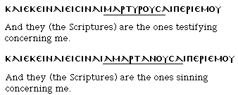
Errors by Sight
John 5:39 – Transposing or Adding Letters

Slide 11
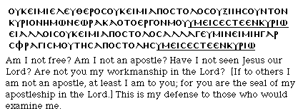

Errors by Sight
John 17:15
1 Corinthians 9:2

Slide 12
Hearing & Memory Errors
Faulty Hearing: Either errors in dictation or even solitary reading
Memory Lapse: During the process of reading and beginning to write it on the copy, a scribe could make mistakes as he repeats the line.
Reversals: Herod the King vs. King Herod
Replacement: Peter vs. Simon; Jesus vs. Lord

Slide 13
Intentional Errors
Sloppy Scribes: “They write down not what they find but what they think is the meaning; and while they attempt to rectify the errors of others, they merely expose their own.” (Jerome)
Spelling and Grammar Changes: Changes in the Greek languages and non-standard spelling

Slide 14
Intentional Errors
Harmonistic Alterations: Since many scribes knew much of their Scriptures by heart, they recognized the places in which there are parallels or quotations which do not completely follow their antecedents.
For example, the shorter form of the Lord's Prayer in Luke was assimilated in many copies of Luke to agree with the longer form in Matthew 6:9-13.

Slide 15
Intentional Errors
Corrections: Presumed historical or geographical conflicts
Conflations: Luke 24:53 ends with the disciples “continually in the temple blessing God.” Codex Bezae has “praising.” Some manuscripts that have the conflation “praising and blessing.”
Doctrinal Alterations: The Church Fathers repeatedly accuse the heretics of corrupting the Scriptures to support their views, like Marcion’s non-Jewish Jesus.

Slide 16
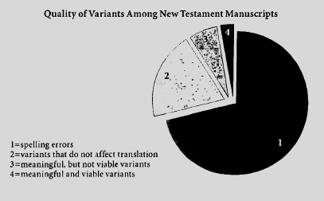
The Overwhelming Evidence
Meaning, viable variants = less than 1%

Slide 17
The Overwhelming Evidence
Daniel Wallace on Variants:
“For more than two centuries, most biblical scholars have declared that no essential affirmation has been affected by the variants.”
“In the last 135 years, not a single new reading of any MS has such a pedigree [as to be both new and viable]. This shows that the autographic wording is to be found among the MSS somewhere.”

Slide 18
Author | Date | Earliest Copy | Difference | Copies
Pliny | 61-113 AD | 850 AD | 750 yrs | 7
Plato | 427-347 BC | 900 AD | 1200 yrs | 7
Herodotus | 480-425 BC | 900 AD | 1300 yrs | 8
Aristophanes | 450-385 BC | 900 AD | 1200 yrs | 10
Caesar | 100-44 BC | 900 AD | 1000 yrs | 10
Sophocles | 496-406 BC | 1000 AD | 1400 yrs | 193
Homer (Iliad) | 900 BC | 400 BC | 500 yrs | 643
NT | 1st Century | 2nd Century | under 100 yrs | 5600+

Slide 19
Other Evidence
Versions
Early in the history of the church, Greek documents, including the Scriptures, were translated into various languages.
By the 3rd and 4th Centuries the New Testament was translated into Coptic, Syriac, Armenian, Georgian, etc.

Slide 20
Other Evidence
Quotations
Metzger: “if all other sources for our knowledge of the text of the New Testament were destroyed, [the patristic quotations] would be sufficient alone for the reconstruction of practically the entire New Testament.”
Irenaeus (2nd Century), Against Heresies 3.10.5: “At the end, moreover, of the gospel Mark says: And so the Lord Jesus, after he had spoken to them, was received into the heavens, and sits at the right hand of God.”

Slide 21
Conclusions
There is overwhelming agreement between the manuscripts (upwards of 95%).
The disagreements between manuscripts are usually easily understood.
Honest Biblical Criticism is helpful, not hurtful, to our faith … because God has successfully preserved His Word.

Slide 22
Case Study: Mark 16
Let’s apply what we have learned to a common question.
Mark 16:9-20

Slide 23
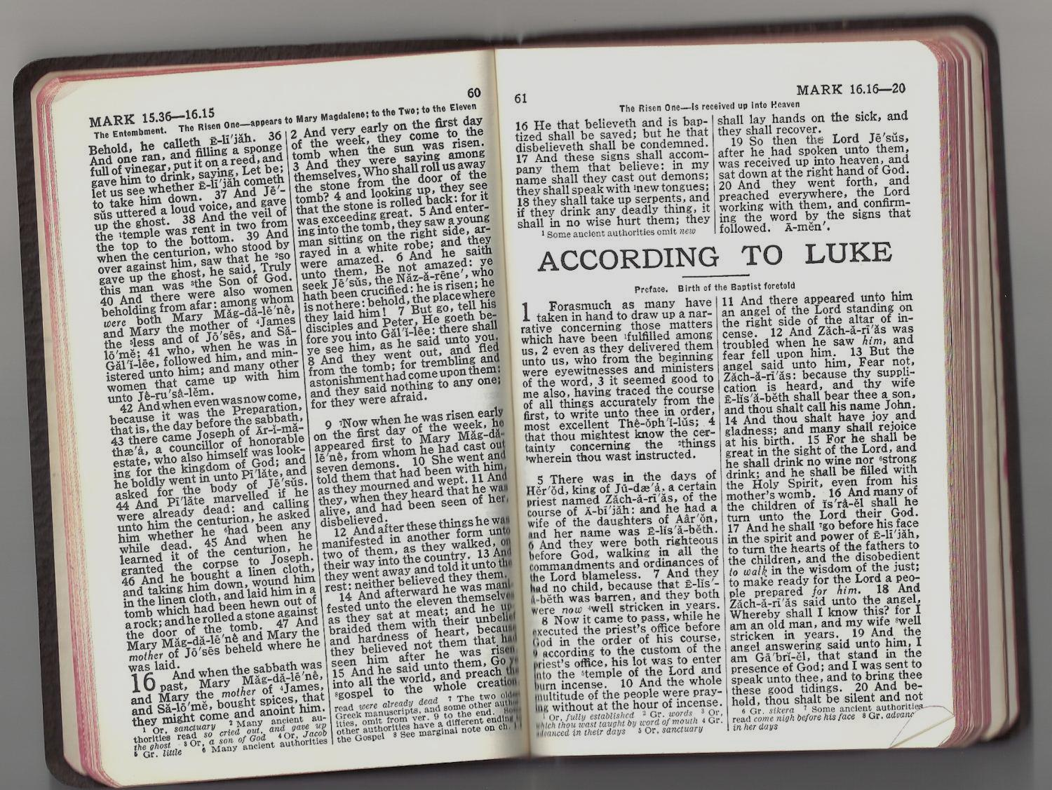
1901 AMERICAN STANDARD
The two oldest Greek manuscripts, and some other authorities, omit from ver. 9 to the end.

Slide 24
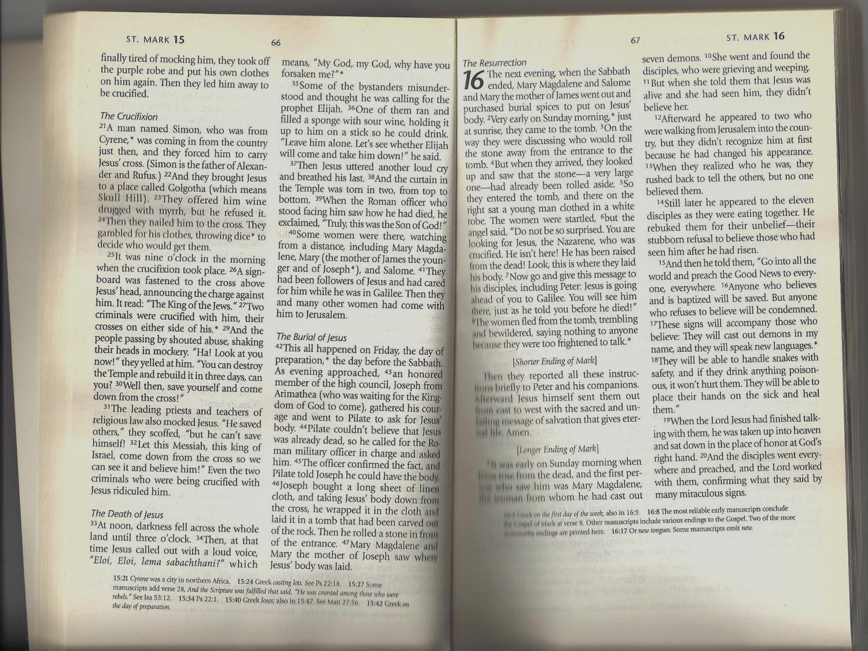
NEW LIVING TRANSLATION
The most reliable early manuscripts conclude the Gospel of Mark at verse 8.

Slide 25
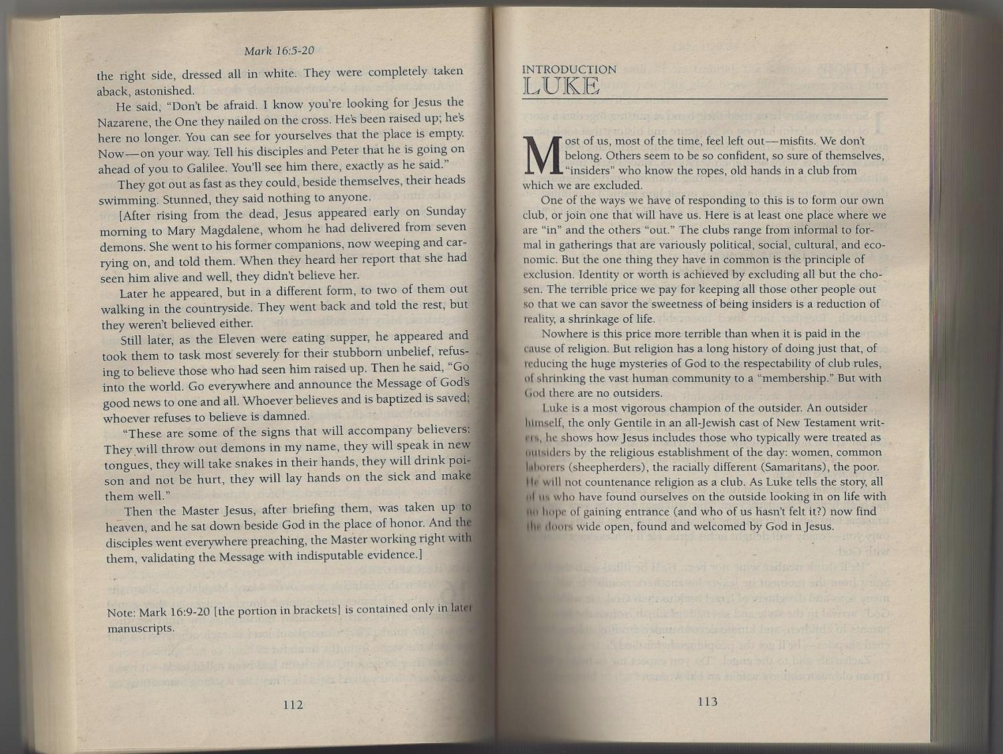
THE MESSAGE
Mark 16:9-20 [the portion in brackets] is contained only in later manuscripts.

Slide 26
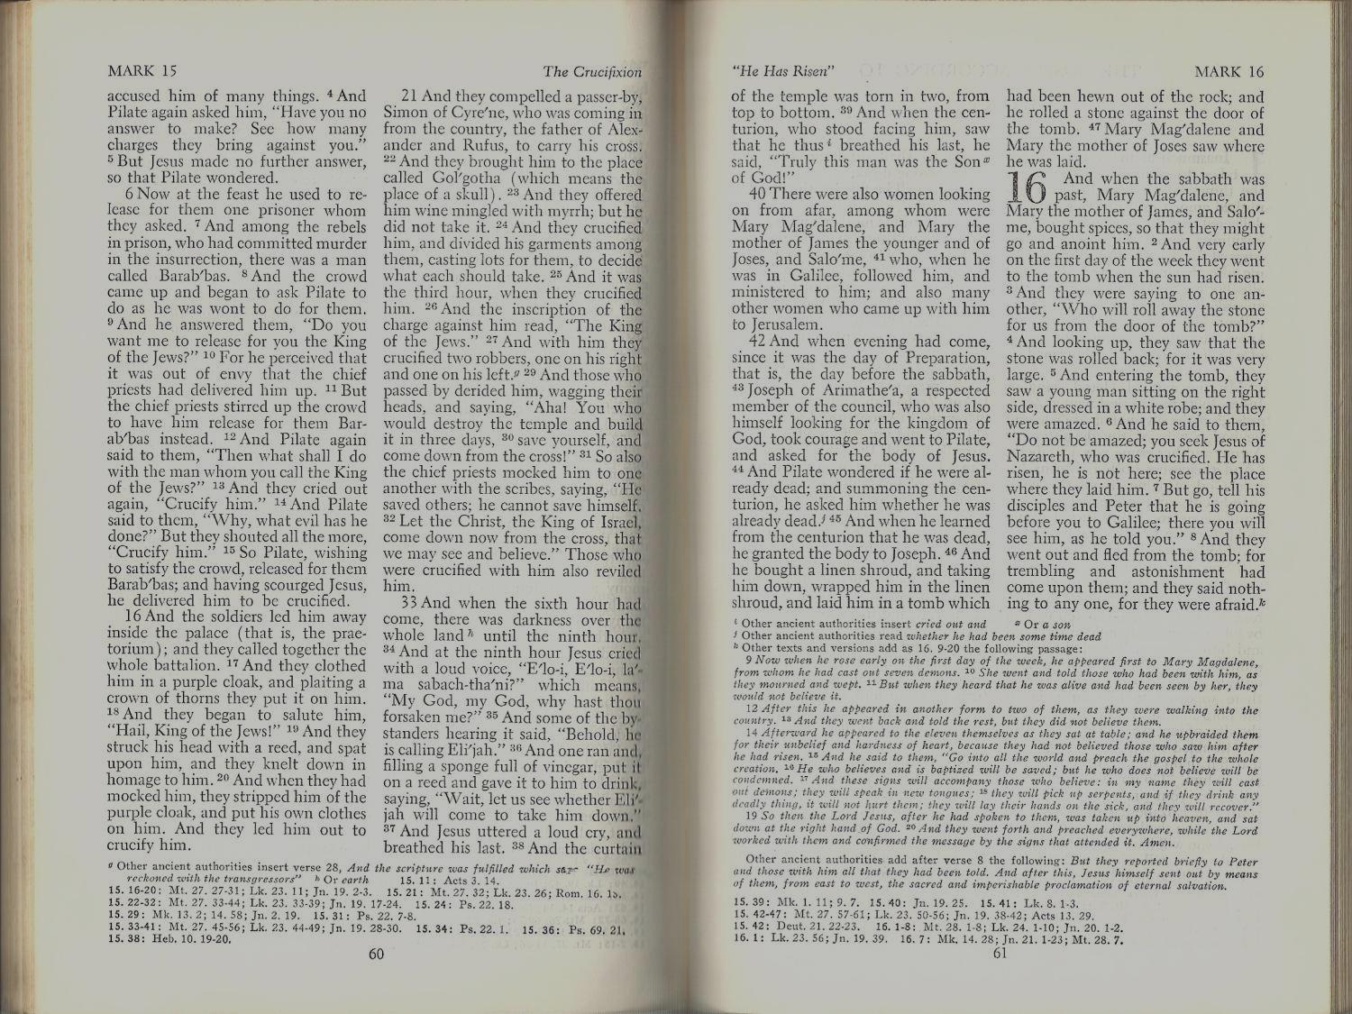
REVISED STANDARD VERSION
Other texts and versions add as 16:9-20 the following passage:

Slide 27
Other Versions
NEW INTERNATIONAL VERSION: “The most reliable early manuscripts and other ancient witnesses do not have Mark 16:9-20”
ENGLISH STANDARD VERSION: “Some of the earliest manuscripts do not include 16:9-20.”

Slide 28
How Many Manuscripts?
5,600+ ancient Greek manuscripts of the New Testament
2,519 Greek lectionaries containing extensive portions of the New Testament
19,284 ancient manuscripts of the New Testament in other languages
The argument against Mark 16:9-20 hinges largely on TWO.

Slide 29
The Big Two
Codex Vaticanus (325-350 AD)
Note: It also omits 1 & 2 Timothy, Titus, Philemon, and Revelation.
Codex Sinaiticus (350 AD)

Slide 30
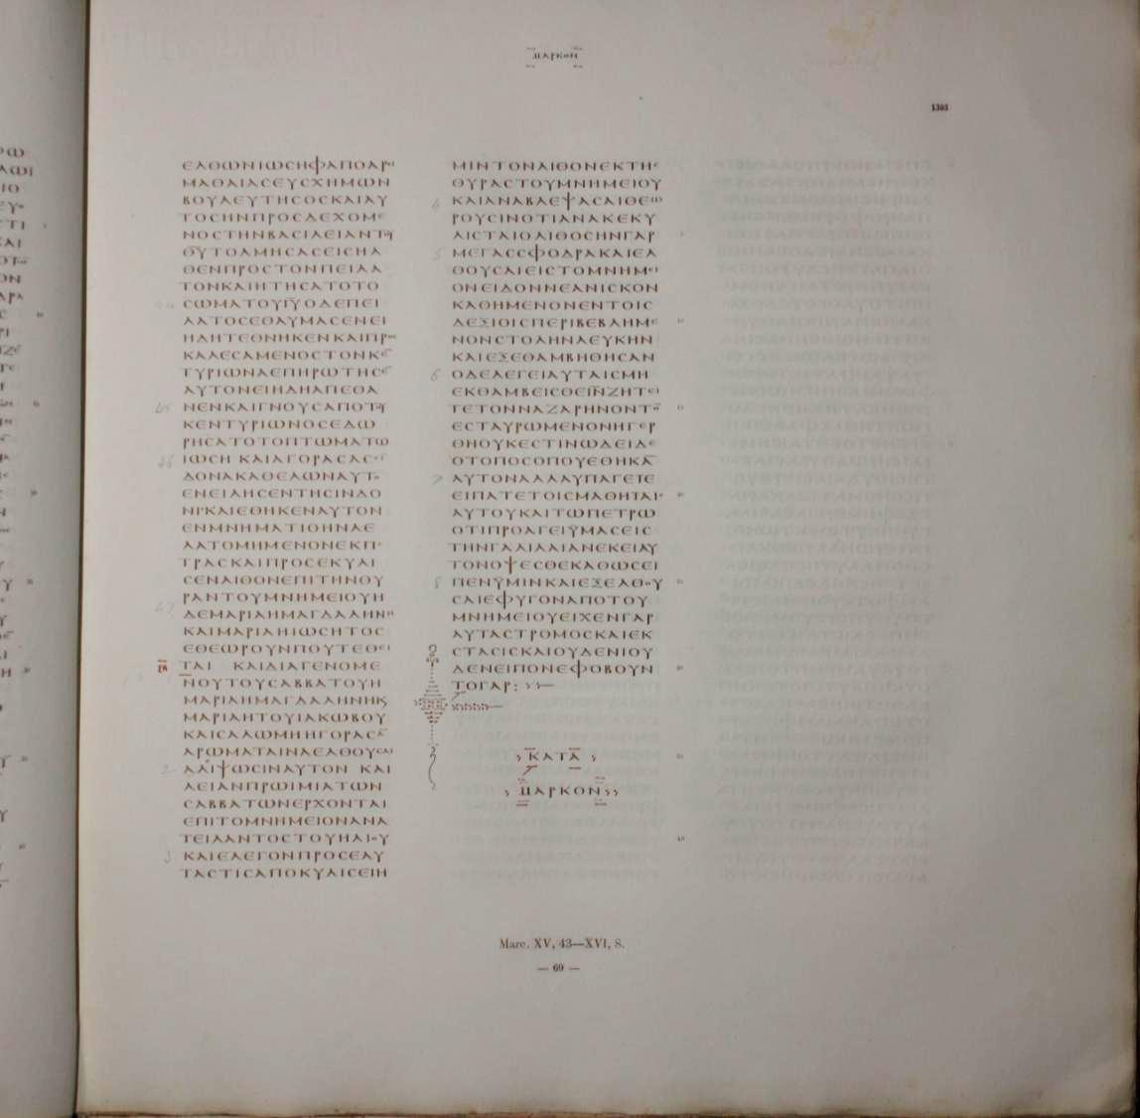
Codex Vaticanus

Slide 31
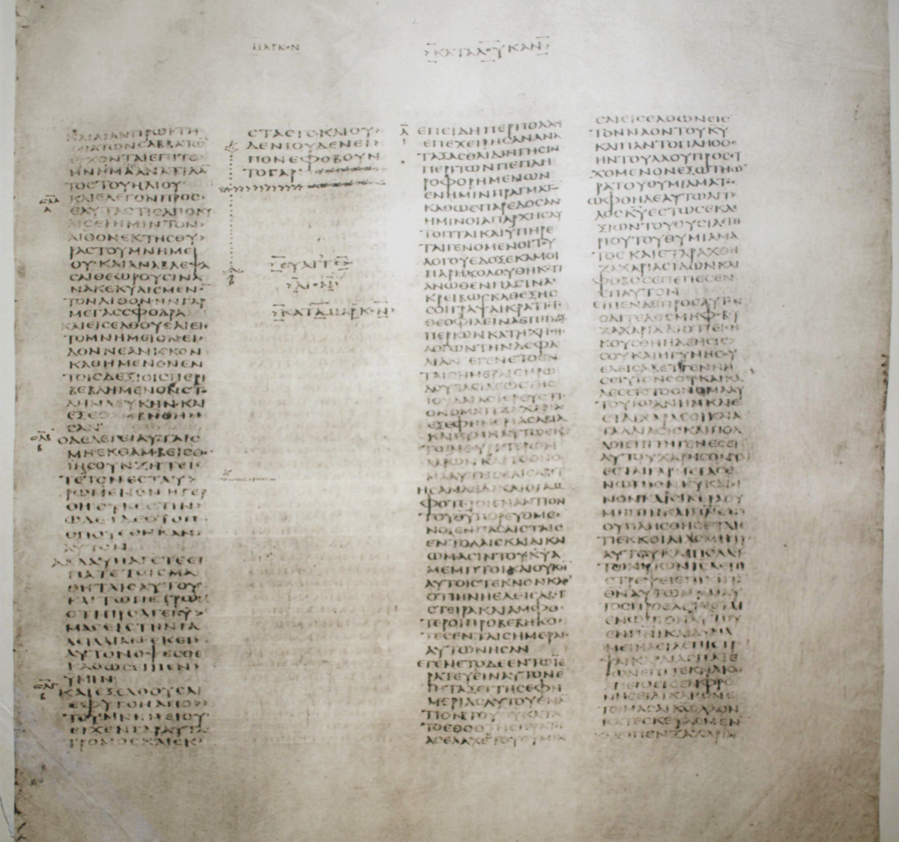
Codex Sinaiticus

Slide 32
Versions With Long Ending
4th Century Versions
Vulgate
Gothic
Aethiopic
2nd Century Versions
Peshitto
Curetonian
Coptic
Sahidic
Tatian’s Diatessaron

Slide 33
Early Christian References
4th Century Quotations
Aphreates
Cyril of Jerusalem
Ephipanus
Ambrose
Chrystom
Augustine
Calendar of church services

Slide 34
Early Christians Quotations
3rd Century Quotations
Hippolytus
Celsus
2nd Century Quotations
Irenaeus
Papias
Justin Martyr

Slide 35
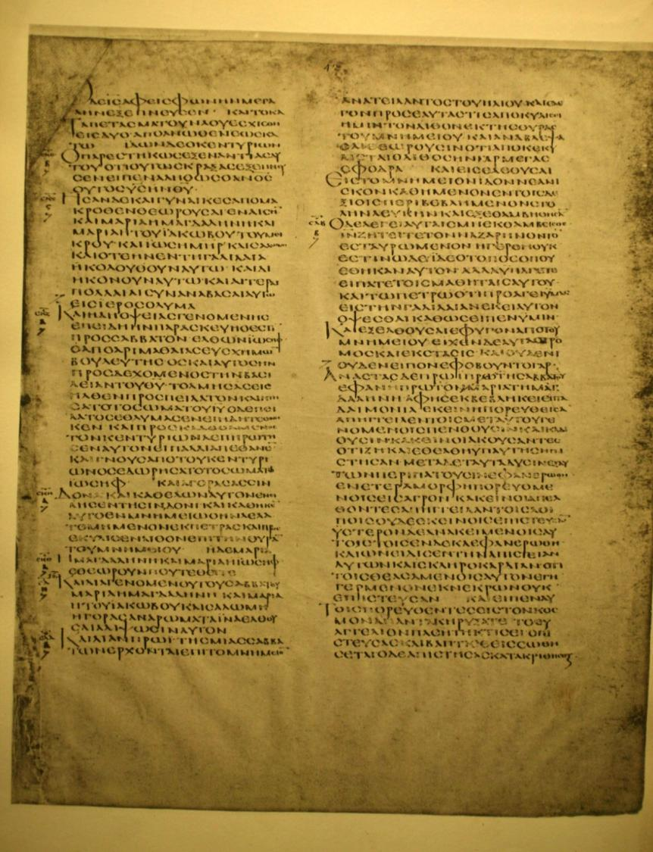

Alexandrian Manuscript
400 AD -- Greek Manuscript
British Museum
Mark 16:16

Slide 36
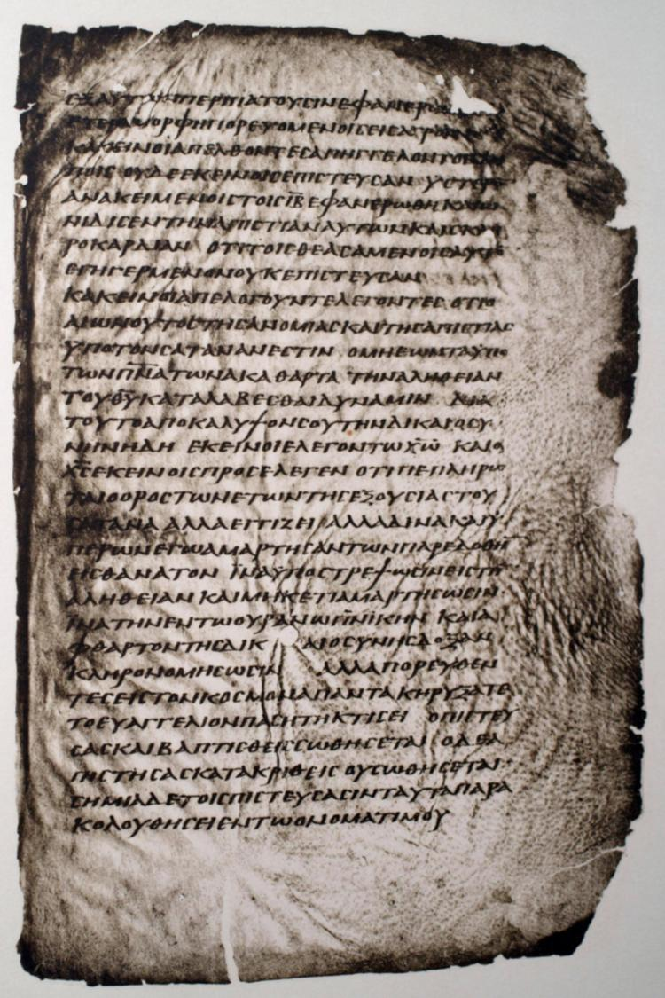
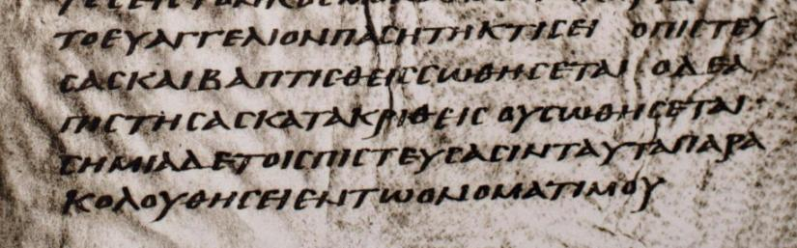
Washington Manuscript
450 AD -- Greek Manuscript
Smithsonian
Mark 16:16

Slide 37
Conclusion on Mark
At the very least, we can say that the textual note in many Bibles is a little bit of an overstatement.
At the very least, Mark has a long ending.
The only viable reading of the end of Mark includes v. 9-20.

